Slide 1
Derivatives

Slide 2
Outline
What is a Derivative?
What is a derivative?
Rules of derivatives

Slide 3

What is a derivative?
A derivative is a function that gives you the slope of some $x$

Slide 4





What is a derivative?
For example, if we have a function $f\left(x\right)$.
$$f\left(x\right)=1$$
$$y$$
$$y=1$$
This will give us a straight line.
$$x$$

Slide 5




What is a derivative?
A straight line has a $slope$ of 0.
$$slope =0$$
If we are to find the derivative of $f\left(x\right)$ which is represented by $f′\left(x\right)$, then its derivative is also 0.
$$y$$
$$f^{′}\left(x\right)=0$$
$$x$$

Slide 6




What is a derivative?
Whenever we get the derivative of some of function with respect to $x,$ We use this notation
$$\frac{dy}{dx}$$
$$y$$
Thus, the derivate of $f\left(x\right)$ with respect to $x$ is,
$$\frac{d}{dx}f\left(x\right)=f′(x)$$
$$x$$

Slide 7
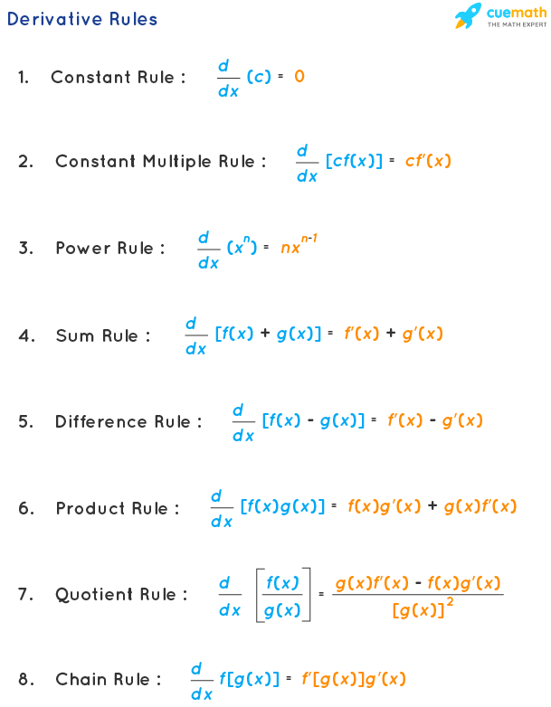



Derivative Rules
$$\frac{d }{d x}\left(c\right)=0$$
1. Constant rule:
2. Constant multiple rule:
$$\frac{d }{d x}[cf(x)] =cf′(x)$$
$$\frac{d }{d x}[x^{n}] =nx^{n−1}$$
3. Power rule:

Slide 8



Derivative Rules
4. Sum rule:
$$\frac{d }{d x}\left[f\left(x\right)+g\left(x\right)\right]=f′\left(x\right)+g′(x)$$
5. Difference rule:
$$\frac{d }{d x}\left[f\left(x\right)−g\left(x\right)\right]=f′\left(x\right)−g′(x)$$
6. Product rule:
$$\frac{d }{d x}\left[f\left(x\right) g\left(x\right)\right]=f\left(x\right)g^{′}\left(x\right)+g(x)f′\left(x\right)$$

Slide 9


Derivative Rules
7. Quotient Rule:
$$\frac{d }{d x}\left[\frac{f\left(x\right)}{g(x)}\right]=\frac{g\left(x\right)f^{′}\left(x\right)−f\left(x\right)g^{′}\left(x\right)}{{[g(x)]}^{2}}$$
8. Chain rule:
$$\frac{d }{d x}f\left[g\left(x\right)\right]=f^{′}\left[\left(g(x\right)\right] g′(x)$$

Slide 10

Constant Rule
$$\frac{d }{d x}\left(c\right)=0$$
The constant rule of derivatives states that the derivative of any constant is 0.

Slide 11



$$\frac{d }{d x}\left(c\right)=0$$
1) $\frac{d }{d x}\left(5\right)=0$
2) $\frac{d }{d x}(−7) =0$

Slide 12

Power Rule
$$\frac{d }{d x}\left(x^{n}\right)=nx^{n−1}$$

Slide 13



$$\frac{d }{d x}\left(x^{n}\right)=nx^{n−1}$$
1) $\frac{d }{d x}\left(x\right)=1x^{1−1}={1x}^{0}=1(1)=1$
2) $\frac{d }{d x}\left(x^{2}\right)=2x^{2−1}={2x}^{1}$

Slide 14


$$\frac{d }{d x}\left(x^{n}\right)=nx^{n−1}$$
3) $\frac{d }{d x}\left(x^{3}\right)=3x^{3−1}={3x}^{2}$
4) $\frac{d }{d x}\left(x^{4}\right)=4x^{4−1}={4x}^{3}$

Slide 15

Constant Multiple Rule
$$\frac{d }{d x}[cf(x)] =cf′(x)$$

Slide 16




$$\frac{d }{d x}[cf(x)] =cf′(x)$$
1) $\frac{d }{d x}\left({4x}^{7}\right)=4 ×\frac{d }{d x}\left(x^{7}\right)$
$\frac{d }{d x}\left({4x}^{7}\right)=4 × 7x^{7−1}$
$\frac{d }{d x}\left({4x}^{7}\right)=4 × 7x^{6}=28x^{6}$

Slide 17



$$\frac{d }{d x}[cf(x)] =cf′(x)$$
2) $\frac{d }{d x}\left({8x}^{4}\right)=8 ×\frac{d }{d x}\left(x^{4}\right)$
$\frac{d }{d x}\left({8x}^{4}\right)=8 × 4x^{4−1}$
$\frac{d }{d x}\left({8x}^{4}\right)=8 × 4x^{3}=32x^{3}$

Slide 18



Derivatives of Polynomials
1) $f\left(x\right)={4x}^{5}+{3x}^{4}+9x$ - 7
$f′\left(x\right)={4(5x}^{4})+{3(4x}^{3})+9(1)$ - 0
$$f′\left(x\right)={20x}^{4}+{12x}^{3}+9$$

Slide 19




Derivatives of Polynomials
2) $f\left(x\right)=x^{2}(x^{3}+7)$
$$f\left(x\right)=x^{5}+7x^{2}$$
$$f′\left(x\right)={5x}^{4}+7(2x)$$
$$f′\left(x\right)={5x}^{4}+14x$$

Slide 20




Derivatives of Radical functions
1) $f\left(x\right)=\sqrt[2]{x}$
$$f\left(x\right)=x^{1/2}$$
$$f^{′\left(x\right)}={\frac{1}{2}x}^{1/2−1}={\frac{1}{2}x}^{−1/2}=\frac{1}{{2x}^{1/2}}$$
$$f′\left(x\right)=\frac{1}{2\sqrt[2]{x}}$$

Slide 21




Derivatives of Radical functions
2) $f\left(x\right)=\sqrt[3]{x^{5}}$
$$f\left(x\right)=x^{5/3}$$
$f^{′\left(x\right)}={\frac{5}{3}x}^{5/3−1}={\frac{5}{3}x}^{5/3−3/3}={\frac{5}{3}x}^{2/3}=$ $\frac{5x^{2/3}}{3}$
$$f′\left(x\right)=\frac{5\sqrt[3]{x^{2}}}{3}$$

Slide 22

Product Rule
$$\frac{d }{d x}\left[f\left(x\right) g\left(x\right)\right]=f\left(x\right)g^{′}\left(x\right)+g(x)f′\left(x\right)$$

Slide 23







$$\frac{d }{d x}\left[f\left(x\right) g\left(x\right)\right]=f\left(x\right)g^{′}\left(x\right)+g(x)f′\left(x\right)$$
1) $\frac{d }{d x}\left[({3x}^{4}+7) (x^{3}−5x)\right]= ?$
$$Let$$
$$f\left(x\right)= {3x}^{4}+7$$
$$g\left(x\right)=x^{3}−5x$$
$$f′\left(x\right)= {12x}^{3}$$
$$g′(x)= {3x}^{2}−5$$

Slide 24






$$\frac{d }{d x}\left[f\left(x\right) g\left(x\right)\right]=f\left(x\right)g^{′}\left(x\right)+g(x)f′\left(x\right)$$
$$Let$$
$$f\left(x\right)= {3x}^{4}+7$$
$$g\left(x\right)=x^{3}−5x$$
$$f′\left(x\right)= {12x}^{3}$$
$$g′(x)= {3x}^{2}−5$$
$$\frac{d }{d x}\left[f\left(x\right) g\left(x\right)\right]={(12x}^{3})\left(x^{3}−5x\right)+{(3x}^{4}+7)({3x}^{2}−5)$$

Slide 25

Quotient Rule
$$\frac{d }{d x}\left[\frac{f\left(x\right)}{g(x)}\right]=\frac{g\left(x\right)f^{′}\left(x\right)−f\left(x\right)g^{′}\left(x\right)}{{[g(x)]}^{2}}$$

Slide 26







$$\frac{d }{d x}\left[\frac{f\left(x\right)}{g(x)}\right]=\frac{g\left(x\right)f^{′}\left(x\right)−f\left(x\right)g^{′}\left(x\right)}{{[g(x)]}^{2}}$$
1) $\frac{d }{d x}[\frac{1}{x}]= ?$
$$Let$$
$$f\left(x\right)=1$$
$$g\left(x\right)=x$$
$$f′\left(x\right)=0$$
$$g′(x)=1$$

Slide 27






$$\frac{d }{d x}\left[\frac{f\left(x\right)}{g(x)}\right]=\frac{g\left(x\right)f^{′}\left(x\right)−f\left(x\right)g^{′}\left(x\right)}{{[g(x)]}^{2}}$$
$$Let$$
$$f\left(x\right)=1$$
$$g\left(x\right)=x$$
$$f′\left(x\right)=0$$
$$g′(x)=1$$
$$\frac{d }{d x}\left[\frac{f\left(x\right)}{g(x)}\right]=\frac{x\left(0\right)−(1)(1)}{{(x)}^{2}}=\frac{0−1}{x^{2}}=\frac{−1}{x^{2}}$$

Slide 28





$$\frac{d }{d x}\left[\frac{f\left(x\right)}{g(x)}\right]=\frac{g\left(x\right)f^{′}\left(x\right)−f\left(x\right)g^{′}\left(x\right)}{{[g(x)]}^{2}}$$
2) $\frac{d }{d x}[\frac{5x+6}{3x−7}]= ?$
$$Let$$
$$f\left(x\right)=5x+6$$
$$g\left(x\right)=3x−7$$
$$f′\left(x\right)=5$$
$$g′(x)=3$$

Slide 29






$$\frac{d }{d x}\left[\frac{f\left(x\right)}{g(x)}\right]=\frac{g\left(x\right)f^{′}\left(x\right)−f\left(x\right)g^{′}\left(x\right)}{{[g(x)]}^{2}}$$
$$Let$$
$$f\left(x\right)=5x+6$$
$$g\left(x\right)=3x−7$$
$$f′\left(x\right)=5$$
$$g′(x)=3$$
$$\frac{d }{d x}\left[\frac{f\left(x\right)}{g(x)}\right]=\frac{\left(3x−7\right)\left(5\right)−(5x+6)(3)}{{(3x−7)}^{2}}$$

Slide 30



$$\frac{d }{d x}\left[\frac{f\left(x\right)}{g(x)}\right]=\frac{g\left(x\right)f^{′}\left(x\right)−f\left(x\right)g^{′}\left(x\right)}{{[g(x)]}^{2}}$$
$$\frac{d }{d x}\left[\frac{f\left(x\right)}{g(x)}\right]=\frac{\left(3x−7\right)\left(5\right)−(5x+6)(3)}{{(3x−7)}^{2}}$$
$$\frac{d }{d x}\left[\frac{f\left(x\right)}{g(x)}\right]=\frac{(15x−35)−(15x+18)}{{(3x−7)}^{2}}=\frac{15x−35−15x−18}{{(3x−7)}^{2}}$$
$$\frac{d }{d x}\left[\frac{f\left(x\right)}{g(x)}\right]=\frac{−53}{{(3x−7)}^{2}}$$

Slide 31


Chain Rule
$$\frac{d }{d x}f\left[g\left(x\right)\right]=f^{′}\left[\left(g(x\right)\right] g′(x)$$
The derivative of the composite function $f$ of $g(x)$ is given by this formula

Slide 32

Chain Rule
$$\frac{d }{d x}f\left[g\left(x\right)\right]=f^{′}\left[\left(g(x\right)\right] g′(x)$$
A composite function can be described as a function being inside of another function. In this formula, $g(x)$ is inside $f$

Slide 33






$$\frac{d }{d x}f\left[g\left(x\right)\right]=f^{′}\left[\left(g(x\right)\right] g′(x)$$
1) $\frac{d }{d x}{[5x+3]}^{4}= ?$
$$Let$$
$$f\left(x\right)={[5x+3]}^{4}$$
$$g\left(x\right)=5x+3$$
$$f′\left(x\right)={4[5x+3]}^{3}$$
$$g′(x)=5$$

Slide 34







$$\frac{d }{d x}f\left[g\left(x\right)\right]=f^{′}\left[\left(g(x\right)\right] g′(x)$$
$$Let$$
$$f\left(x\right)={[5x+3]}^{4}$$
$$g\left(x\right)=5x+3$$
$$f′\left(x\right)={4[5x+3]}^{3}$$
$$g′(x)=5$$
$\frac{d }{d x}{[5x+3]}^{4}={4[5x+3]}^{3}×5$
$\frac{d }{d x}{[5x+3]}^{4}={20(5x+3)}^{3}$

Slide 35





$$\frac{d }{d x}f\left[g\left(x\right)\right]=f^{′}\left[\left(g(x\right)\right] g′(x)$$
2) $\frac{d }{d x}{[x}^{2}{−3x]}^{5}= ?$
$$Let$$
$$f\left(x\right)={[x}^{2}{−3x]}^{5}$$
$$g\left(x\right)=x^{2}−3x$$
$$f′\left(x\right)={5[x^{2}−3x]}^{4}$$
$$g^{′}\left(x\right)=2x−3$$

Slide 36






$$\frac{d }{d x}f\left[g\left(x\right)\right]=f^{′}\left[\left(g(x\right)\right] g′(x)$$
$$Let$$
$$f\left(x\right)={[x}^{2}{−3x]}^{5}$$
$$g\left(x\right)=x^{2}−3x$$
$$f′\left(x\right)={5[x^{2}−3x]}^{4}$$
$$g^{′}\left(x\right)=2x−3$$
$\frac{d }{d x}{[x^{2}−3x]}^{5}={5(x^{2}−3x)}^{4} (2x−3)$

